Slide 1

EMPLOYEE RETENTION
HR-Analytics Employment Retention

Slide 2

Mentor: Dipti Sinha Project Members : Pallavi Jadhav Diksha Gawhad Minakshee Chavan Ache Sravani Jaya Surya Adithya SR

Slide 3
AGENDA :
Introduction & Problem Statement
Business Objective
KPIs
Dashboard
Conclusion

Slide 4
Introduction:
Problem Statement:
Average attrition rate for all Departments
Average hourly rate of Male Research Scientist
Attrition rate vs. Monthly Income stats
Average working years for each Department
Job role vs. Work-life balance
Attrition rate vs. Years Since last promotion
HR analytics involves collecting and analyzing HR-related data, including employee data, performance metrics, and other relevant data points. By using advanced analytical tools and techniques, HR analytics provides valuable insights into HR processes and trends, enabling organizations to make more informed decisions about their employees and improve overall performance.

Slide 5
Business Objective:
The aim of this project is to analyze employee retention and attrition rates within the organization and provide insights to the HR team for developing effective retention strategies. Through data analysis and visualizations, we will identify factors that contribute to :
Employee turnover and attrition.
Evaluate the effectiveness of existing retention strategies.
To verify the satisfaction level of employees in the organization.
Provide recommendations to improve employee retention.

Slide 6
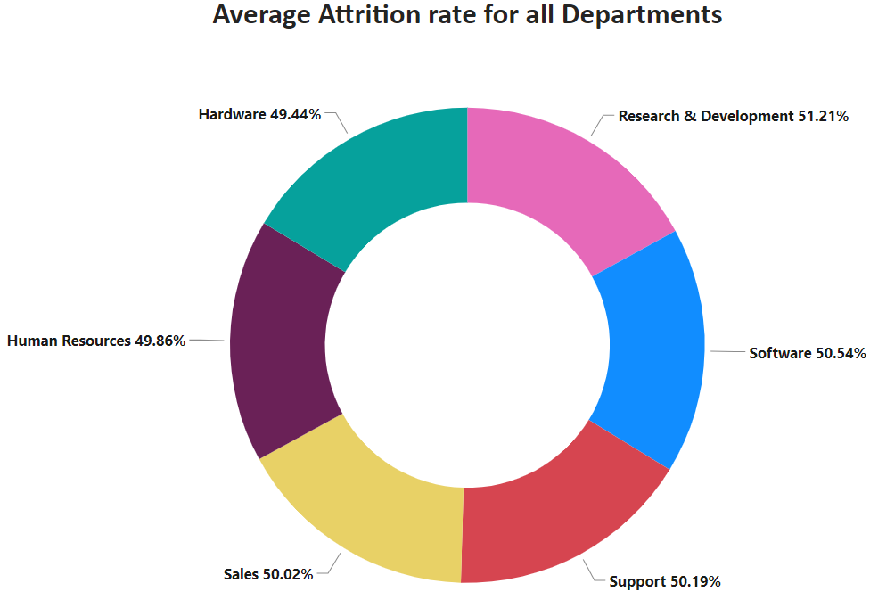
KPI 1 Average Attrition rate for all Departments
This KPI is to find out the
relationship between each
department and its attrition rate and here attrition rate is highest for the Research & Development Department whereas the lowest is for the Hardware Department.

Slide 7
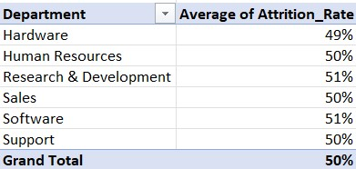
Insights from KPI 1:
We can clearly say that attrition rate of employees for every department is almost 50% which indicates that attrition rate of employees does not depends on department. So, irrespective of the department almost 50% of employees are leaving the company.
From this calculation and visualization, we concluded that we must make strong strategies to minimize the attrition rate and improve our company’s Employee retention so that we can balance the company’s growth and the right talent.

Slide 8
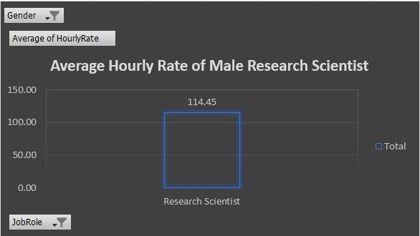
KPI 2 Average Hourly Rate of Male Research Scientists
Insights:
This KPI is to find out the average hourly rate of male research scientists which is 114.45.

Slide 9
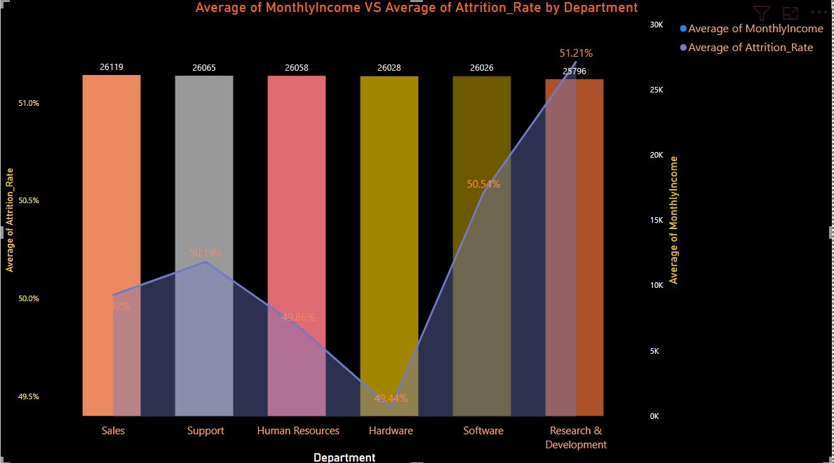
KPI 3 Attrition Rate Vs Monthly Income Stats
This KPI is to find out the relation between monthly income and Attrition rate.

Slide 10
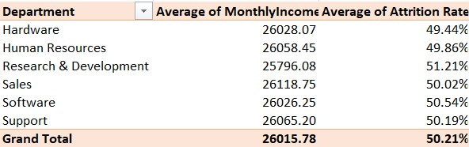
Insights from KPI 3:
Based on our analysis and visualization, it is evident that the Hardware Department has the lowest attrition rate of 49.44%, with an average monthly income of Rs. 26,028.07. On the other hand, the Research and Development Department has the highest attrition rate of 51.21%, with an average monthly income of Rs. 26,796.08

Slide 11
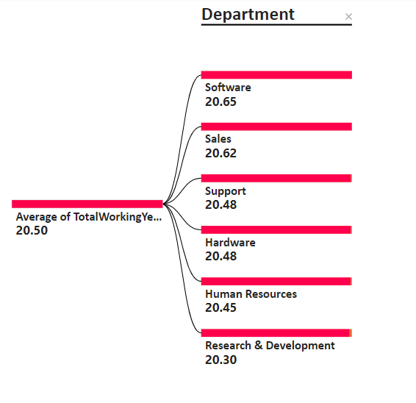
KPI 4 Average Working Years for each Department

Slide 12
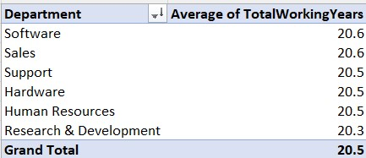
Insights from KPI 4:
From this we can see the average working years in software department is high as compared to the rest of the departments and lowest is for Research & Development Department.
From the analysis we can conclude that average working years is approximately 20 for all the departments.

Slide 13
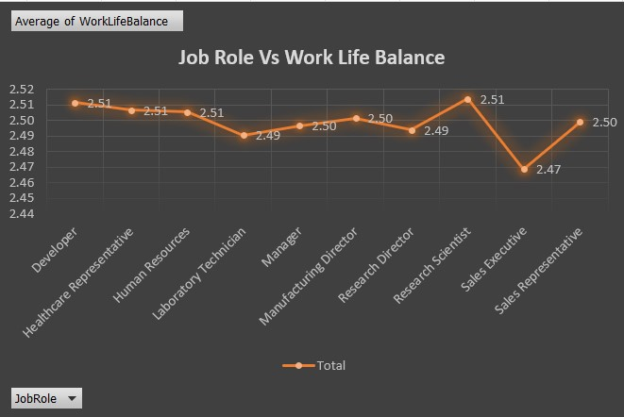
KPI 5 Job Role Vs Work-Life Balance for Total Employees

Slide 14
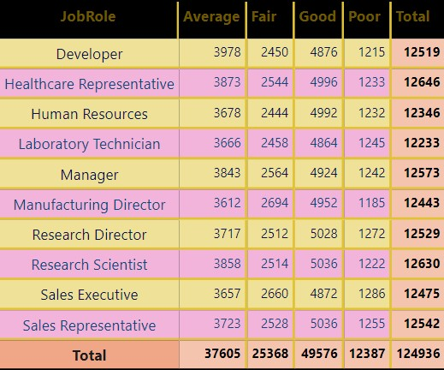
Insights from KPI 5:
From the analysis, we can conclude that,
For Research directors and laboratory technicians, the work-life balance is poor.
For the Sales representatives, managers, Manufacturing Directors, and Sales executives the work-life balance is fair.
For Research Scientists, Healthcare representatives, and Developers the work-life balance is good.
For human resources the work-life balance is excellent.

Slide 15
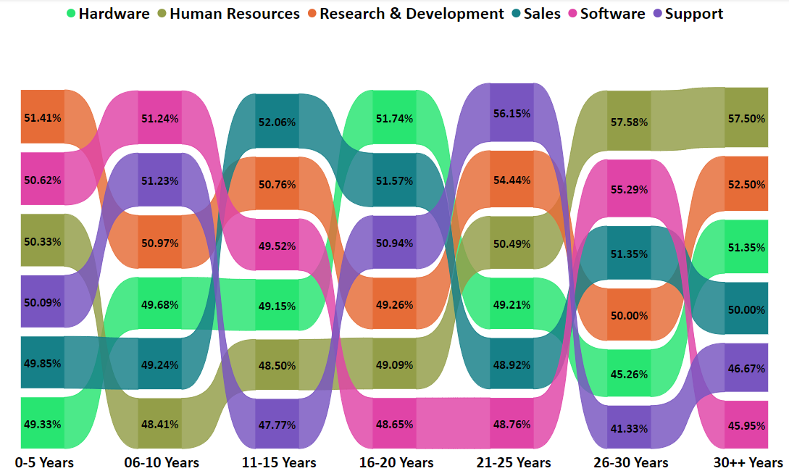
KPI 6 Attrition Rate Vs Years Since Last Promotion

Slide 16
Insights from KPI 6:
From the analysis and Visualisation :
1. For 0-5 years since Last year Promotion interval Research & Development and Hardware departments has the highest and lowest attrition rate respectively.
2. For 6-10 years since last year’s promotion interval Human resources and software departments has the highest and lowest attrition rate respectively.
3. For 11-15 years since the last promotion interval support and sales departments has the highest and lowest attrition rate respectively.
4. For 16-20 years since the last promotion interval software and hardware departments has the highest and lowest attrition respectively.
5. For 21-25 years since the last promotion interval software and support departments have the highest and lowest attrition respectively.
6. For 26-30 years since the last promotion interval support and Human resources departments have the highest and lowest attrition respectively.
7. For above 30 years since the last promotion interval software and Human resources departments have had the highest and lowest attrition respectively.

Slide 17
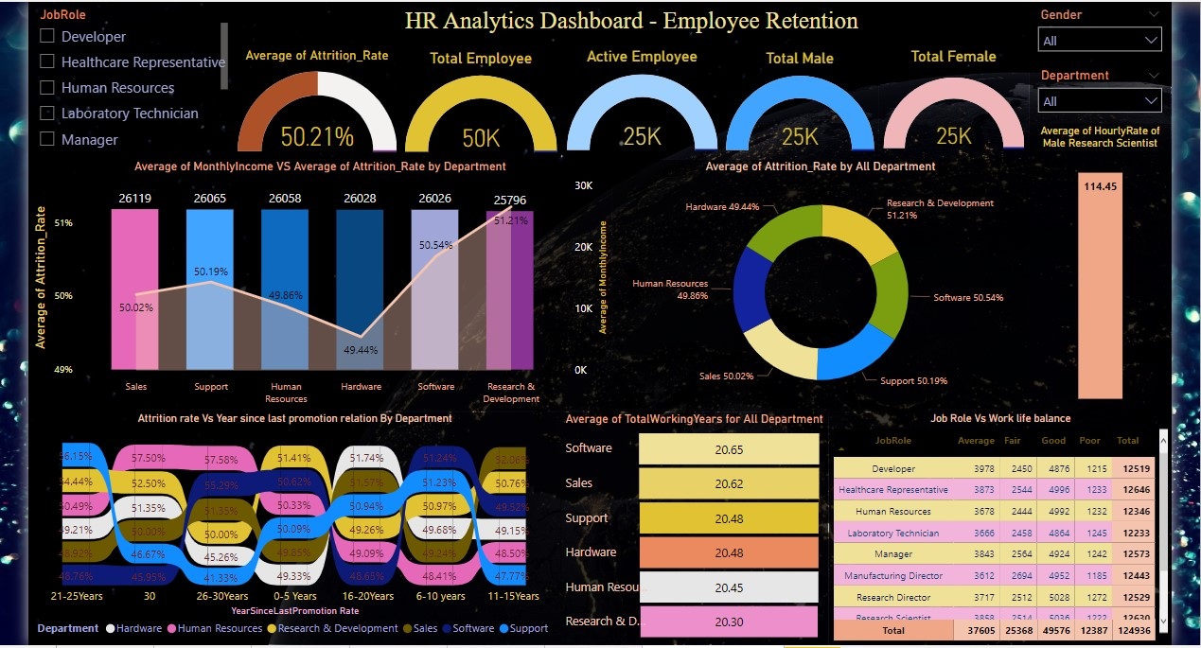

Slide 18
Conclusion :
Conduct stay interviews: Instead of exit interviews, conduct stay interviews with employees to gather feedback about the job.
Improve employee engagement: Implement initiatives to improve employee engagement, such as regular feedback, recognition and rewards programs, and opportunities for career growth.
Address workload issues: Ensure employees have manageable workloads by regularly monitoring and adjusting workloads to prevent burnout and overwhelm.
Create a positive work environment: Foster a positive work environment by promoting a culture of respect, inclusivity, and teamwork. Encourage open communication and collaboration among employees.
Address pay and compensation issues: Ensure that employees receive fair pay and compensation for their work and to find out what motivates an employee to continue to work in an organization.

Slide 19

Thank you

